Slide 1

CasaLingua: Making Bloom More Accessible
Created By: Arnulfo Gonzalez Jr, Danny Newton, EmJ Webb, James Wilson, Kyle Frese
Created For: Bloom, Exygy, Justice Through Code

Slide 2
CasaLingua’s Vision
"We envision a world where language is never a barrier to housing access—where every housing seeker can confidently navigate the path to stable housing with dignity, understanding, and equal opportunity."

Slide 3





Meet The Team
Arnulfo Gonzalez Jr. Enthusiastic full-stack developer passionate about learning and building. Always eager to tackle new challenges, collaborate, and grow my skills in software development and problem-solving.
Dan Newton Programmer, musician, and problem solver with a background in military communications and full-stack development. Focused on impactful tech projects like ILARJ and Exygy Bloom Housing. Skilled, adaptable, and always ready to collaborate—with code or a bass guitar.
EmJ Webb Passionate MERN stack developer focused on using tech to transform lives. With skills in React, JavaScript, and team collaboration, she brings insight, humility, and a strong drive to learn and grow. Her mission: to serve, empower, and build through code
Our team brings together developers from a diverse background with the same mission in mind: To break down language barriers in housing by transforming complex documents into clear, accessible information that empowers all people to understand their housing rights, options, and responsibilities, regardless of language proficiency or literacy level.
James Wilson I solve complex rail industry problems by combining hands-on field experience with software solutions. With a background in quality leadership and software engineering, I streamline diagnostics, reduce non-conformances, and build real-time dashboards that drive smarter, safer decisions.
Kyle Frese Results-driven product and project manager with diverse background in tech and non-tech fields delivering projects on time and within budget. Equally passionate about providing platforms for impacted communities to be given every chance to succeed.

Slide 4
What We Are Trying to Address
Housing documentation is inaccessible to many potential housing seekers due to complex language, legal terminology, and limited translation options. This creates substantial barriers to housing access, particularly for individuals with limited English proficiency or literacy challenges.
How We Are Going to Address It
CasaLingua is a revolutionary AI-powered platform that transforms complex housing documents into clear, accessible language while maintaining legal accuracy across multiple languages.
Our dual AI architecture combines specialized simplification and translation engines, both trained specifically on housing documentation and policies. Unlike general-purpose language tools, CasaLingua understands the nuances of housing terminology across jurisdictions and languages.

Slide 5




How We Get There
Research, Research, Research
CasaLingua’s developers have spent time interviewing current users to find their pain points so we can accurately address them in a meaningful way
This is all about accessibility. We make sure that we have the most common languages spoken in those markets so that we can engage with as large of a segment of the population as possible
Seamless Connectivity
We ensure that we are connected to all of the relevant local and national policy repositories, so our AI integrations can leverage the most up to date documentation
CasaLingua’s API integrations allow for quick responses but most importantly, it allows for offline usage as well so our users are not reliant on connectivity
We Don’t Lose the Human Touch
A human is involved at almost every point throughout this process, from beginning to end. CasaLingua maintains a collaborative approach both from the applicant perspective but also from the maintainer’s perspective to ensure compliance
Iterate, Demo, & Test Often
Staged releases allow for user feedback, compliance checks, and ensuring that the human is still the determining factor, not any AI model or LLM. Trust is everything, and we reinforce that trust at every step.

Slide 6

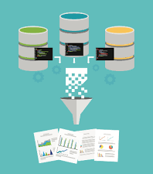


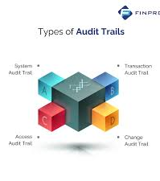
Our Technical Approach
Secure Upload & Authorization
Self-Contained Simplification AI
Human Review & Approval Flow
Usage Analytics, Training, and Fine Tuning
API gateway authenticates and routes users to document upload service. Files are then stored securely
Using a specific model to convert legal/housing documents into simplified, legally compliant language
Documents are visually verified, edited, and approved collaboratively before publication.
User behavior and feedback is logged, while maintaining training, versioning, and fine tuning is iterative.
User Interface Triggers
Web UI Mobile App
API Clients
Bloom Integration
Parse Documents
Multi-lingual Translation
Publishing
Audit Trails & Deployment
Using a variety of tools, the parser extracts content and metadata, determining what needs to be simplified
Culturally-adapted AI translations with outputs that are checked for quality and stored in memory
Approved documents formatted and published and delivered to users
All AI logs are maintained to monitor and investigate ethical risks. Robust DevOps and secure storage is maintained in trusted environment

Slide 7

Integrating With Bloom
Seamless API-to-API Integration
Secure, off-line compliance checks with human approval at key checkpoints
This allows for the simplification of uploaded documents
It maintains or develops plain-language eligibility information
Allows us to integrate translated program rules and forms
This allows us to build, develop, and maintain trust across all key stakeholders
Further allows for any type of unethical behavior or guidance provided by AI

Slide 8


User Journey Mapping
User Uploads Housing Documentation
AI Classifies & Segments Document Content
Readable, Digestible Output is Generated
[Future State] Multi-modal input and output
User provides feedback for model accuracy
Continuous Human Review & Involvement
Identified Primary Users
Social Workers
Nurses
Housing Administrators
Civil Servants
Housing Applicants

Slide 9
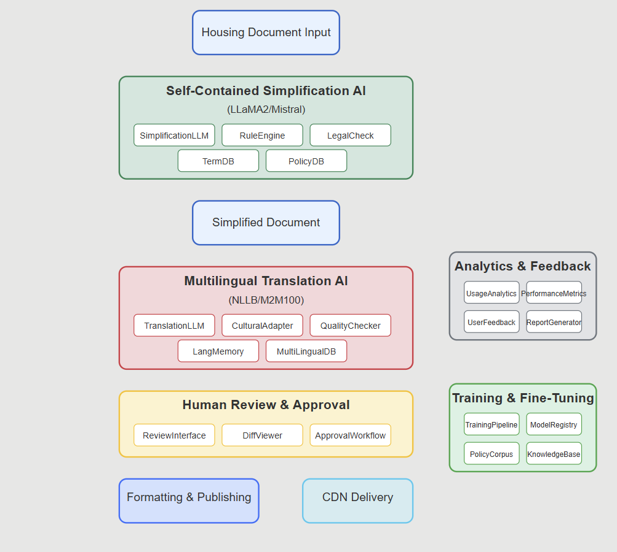
AI Interaction Flow
The CasaLingua platform transforms complex housing documents into accessible language across multiple literacy levels and languages through a sophisticated AI pipeline. Beginning with self-contained simplification models running locally on LLaMA2/Mistral architecture, content flows through multilingual translation, human expert review, and finally to users—all while continuously improving through robust analytics and training feedback loops.

Slide 10


Addressing Concerns
Trust is everything. Those utilizing our system on all aspects of the user side need to know and trust that our models are not only accurate, but truthfully and legally compliant as well. Here is how are address those common concerns and get ahead of issues that have plagued similar efforts in other sectors
Compliance & Reliability
Our solution is NOT a generalized conversation model
Our model institutes several checks and validations to maintain contextual, syntactical, legal, and ethical integrity
CROSS-VALIDATION: There are two models in the CasaLingua architecture, each performing their own tasks as well as the ability to ‘sanity-check’ the outputs of the other.
In conjunction with this are comprehensive auditing elements, Human-in-the-loop observability and correction, and adherence to ethical and bias concerns with proven guardrails and published guidelines.
LEGAL: The model is trained on a corpus of language defined by and specific to each jurisdiction being served
Comprehensive human readable auditing of every input/output to the pipeline.
The corpus of language can easily be adapted to fit the inevitable changes in the legal landscapes that occur.
HALLUCINATIONS/CONFABULATIONS
GPT-type models seek to confidently answer questions by offering up the most likely words or phrases applicable to a question.
Our model does not implement a pipeline allowing for ‘best-guess’ or ‘likely’ answers to questions. The model performs accessible translation services within a fixed-scope subject and does not scrape unvetted sources of data.
If an interaction fails in some way, the reason for this is clearly audited and can be fielded and corrected by “Human-in-the-loop”.
Corrections to failures are reincorporated into the corpus of data the models base their knowledge upon

Slide 11
Now, what might it cost?
Resources are finite, and not every jurisdiction and user will have the same resources available to them. We get more efficient over time, and those costs are passed on to the user.
Initial Training Cost
Model | Parameters | GPU RAM Needed | GPU Hours 1 Epoch | GPU Hours 2 Epochs | Estimated Cost (USD)
TinyLlama | 1.1B | 12–16 GB | 6–10 | 12–20 | $24–40
Mistral | 7B | 24–48 GB | 35–60 | 70–120 | $140–240
Mixtral | 12.9B | 48–80 GB | 70–100 | 140–200 | $280–400
Current reasonable estimates indicate API computational and space requirements to the existing Bloom Housing infrastructure would be approximately 10x current, non-AI module, operations. We will provide accurate usage metrics when we have more information on currently used Bloom Housing platform/infrastructure.
API Call Cost Per Run
Model | Cost per 1K Input tokens | Cost per 1k Output Tokens | Estimated Cost per run
GPT-4 Turbo | $0.01 | $0.03 | ~$0.0048
Claude 3 Opus | $0.015 | $0.075 | ~$0.0108
Mistral (via Fireworks) | $0.002 | $0.004 | ~$0.00072

Slide 12




Thank you
The Casa Lingua Team

